Slide 1
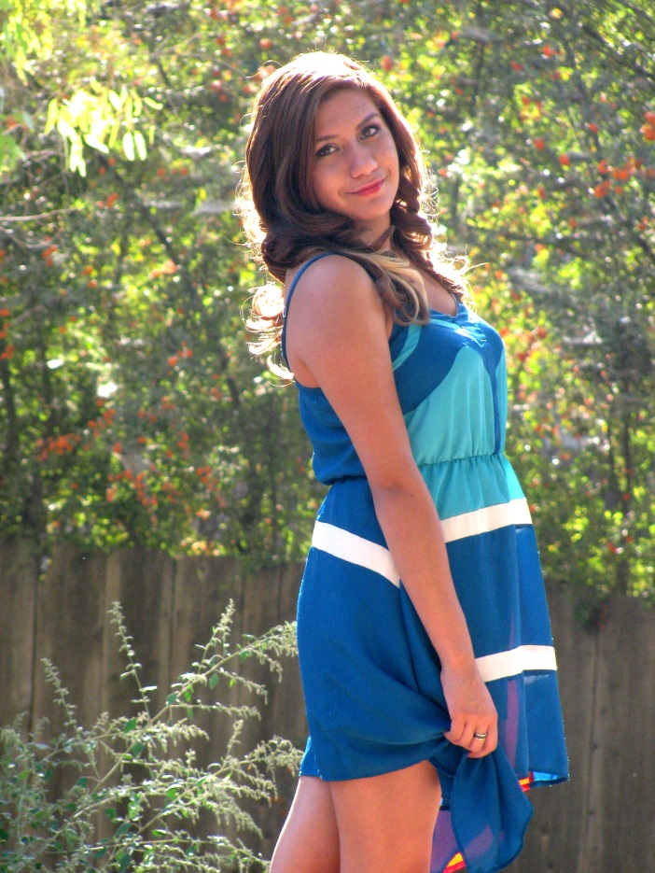
Andrea Torres
Class of 2014
Exit interview

Slide 2
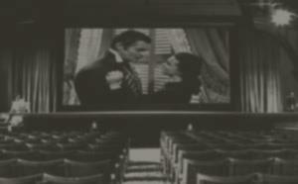
Life isn’t a movie

Slide 3
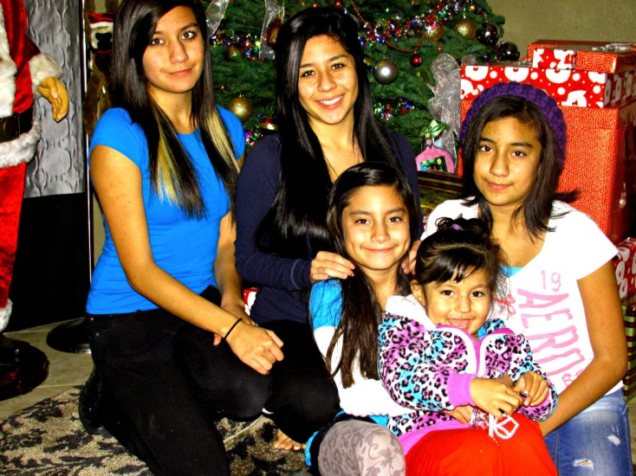
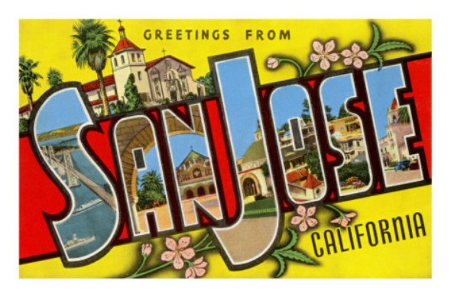
About Me
Born in San Jose
2nd oldest of 5 girls
Creative
Participated in Cross country, CSF,
Spanish Honor’s Society, Book Club, and FBLA

Slide 4
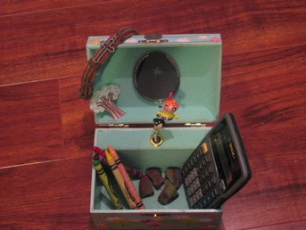
Most meaningful to me
Visual representation
– Found something I didn’t know

Slide 5
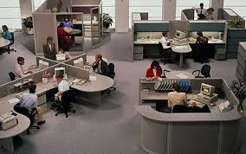
Job Shadow- real estate broker
Communication, organization, emotional strength
Flexible with college students
Wouldn’t apply

Slide 6
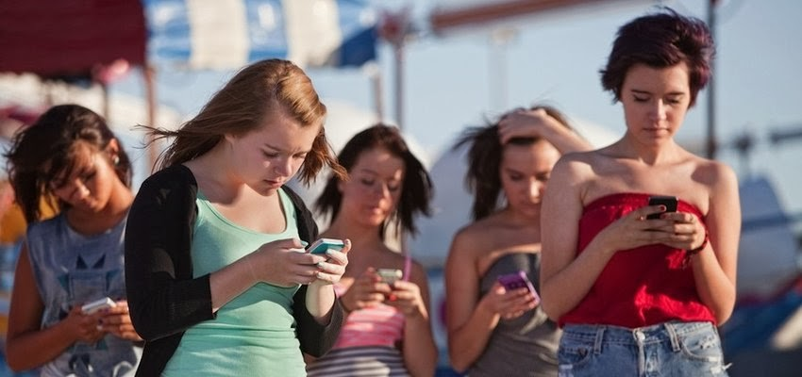
Research Topic
Teenagers + Technology
Level 4: 7 essays
Choose it because can relate
Learned about technology’s affect
Relates to my future by enjoying the world

Slide 7
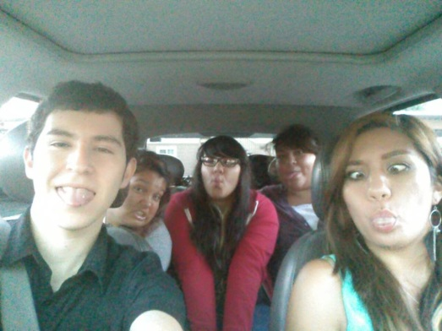
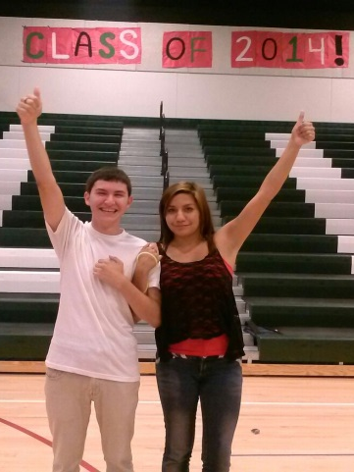
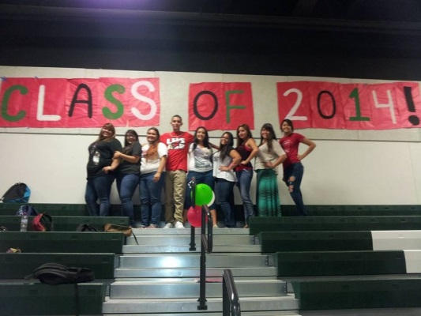
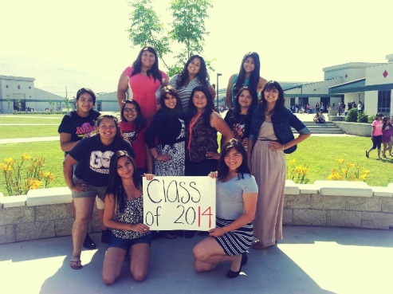
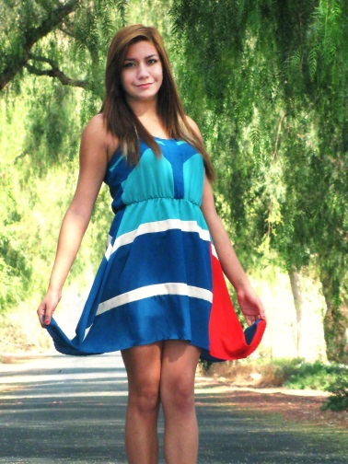
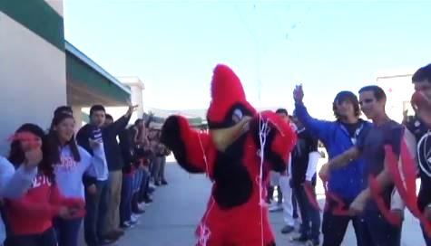
Journals
Most meaningful month: August
What I learned: Hard work pays off
Biggest accomplishment: My video
Biggest challenge: My future
My future: Attend a university

Slide 8
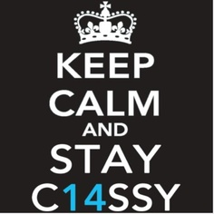
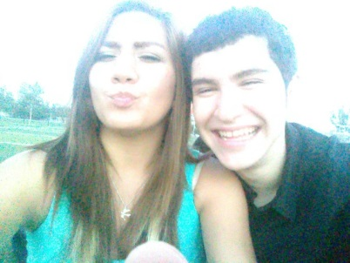
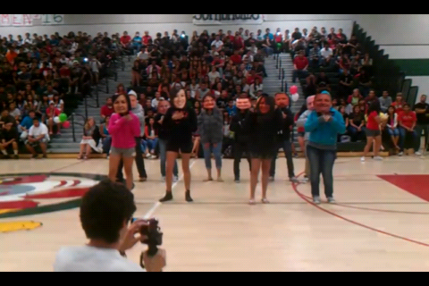
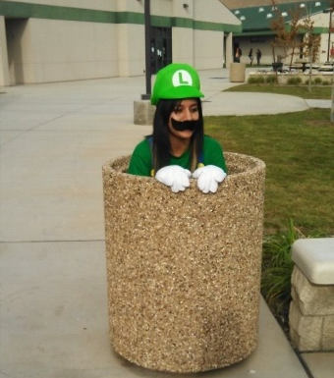
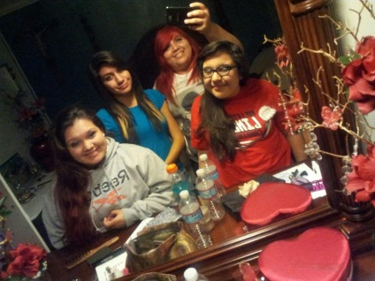
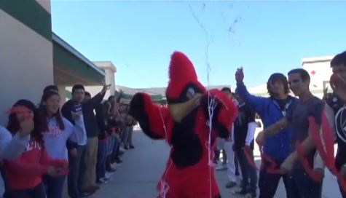
Thank you!
I appreciate your time and interest in my senior project
Questions?

